Slide 1

Trees
"A tree may grow a thousand feet tall, but its leaves will return to its roots."
-Chinese Proverb
CLRS, Section 10.4

Slide 2
What is a Tree?
In computer science, a tree is a implementation-dependent data structure representing a hierarchical structure.
A tree consists of nodes with a parent-child relation.
Applications:
Organization charts
File systems
Programming environments
Computers”R”Us
Sales
Manufacturing
R&D
US
International
Laptops
Desktops
Europe
Asia
Canada

Slide 3
Tree Terminology
Root: node without parent (A)
Internal node: node with at least one child (A, B, C, F)
External node (a.k.a. leaf ): node without children (E, I, J, K, G, H, D)
Ancestors of a node: parent, grandparent, grand-grandparent, etc.
Depth of a node: number of ancestors
Height of a tree: maximum depth of any node (3)
Descendant of a node: child, grandchild, etc.
A
B
C
D
E
F
G
H
sub-tree
I
J
K
Sub-tree: tree consisting of a node and its descendants, grandchildren, etc.

Slide 4
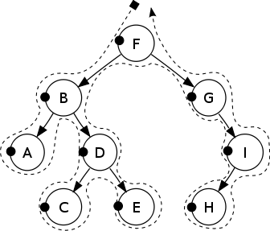

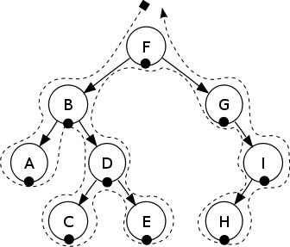
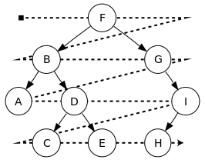
Tree Traversal
A tree traversal visits the nodes of a tree in a systematic manner.
Four types of traversal:
Pre-order
Post-order
In-order
Level-order
pre-order
post-order
in-order
level-order

Slide 5
Pre-order Traversal
In a pre-order traversal, a node is visited before its descendants.
Application: Print a structured document.
Algorithm preOrder(v)
visit(v)
for each child w of v
preOrder (w)
1
Make Money Fast!
2
5
9
1. Motivations
2. Methods
References
3
4
6
7
8
1.1 Greed
1.2 Avidity
2.1 Stock Fraud
2.2 Ponzi Scheme
2.3 Bank Robbery

Slide 6
Pre-order Traversal
1
Make Money Fast!
2
5
9
1. Motivations
2. Methods
References
3
4
6
7
8
1.1 Greed
1.2 Avidity
2.1 Stock Fraud
2.2 Ponzi Scheme
2.3 Bank Robbery
Algorithm preOrder(v)
visit(v)
for each child w of v
preOrder (w)
preOrder(Make Money Fast!)
visit(Make Money Fast!) // 1
preOrder(1. Motivations) // left child

Slide 7
Pre-order Traversal
1
Make Money Fast!
2
5
9
1. Motivations
2. Methods
References
3
4
6
7
8
1.1 Greed
1.2 Avidity
2.1 Stock Fraud
2.2 Ponzi Scheme
2.3 Bank Robbery
Algorithm preOrder(v)
visit(v)
for each child w of v
preOrder (w)
preOrder(1. Motivations)
visit(1. Motivations) // 2
preOrder(1.1 Greed) // left child

Slide 8
Pre-order Traversal
1
Make Money Fast!
2
5
9
1. Motivations
2. Methods
References
3
4
6
7
8
1.1 Greed
1.2 Avidity
2.1 Stock Fraud
2.2 Ponzi Scheme
2.3 Bank Robbery
Algorithm preOrder(v)
visit(v)
for each child w of v
preOrder (w)
preOrder(1.1 Greed)
visit(1.1 Greed) // 3
return // no children

Slide 9
Pre-order Traversal
1
Make Money Fast!
2
5
9
1. Motivations
2. Methods
References
3
4
6
7
8
1.1 Greed
1.2 Avidity
2.1 Stock Fraud
2.2 Ponzi Scheme
2.3 Bank Robbery
Algorithm preOrder(v)
visit(v)
for each child w of v
preOrder (w)
preOrder(1. Motivation)
preorder(1.2 Avidity) // right child

Slide 10
Pre-order Traversal
1
Make Money Fast!
2
5
9
1. Motivations
2. Methods
References
3
4
6
7
8
1.1 Greed
1.2 Avidity
2.1 Stock Fraud
2.2 Ponzi Scheme
2.3 Bank Robbery
Algorithm preOrder(v)
visit(v)
for each child w of v
preOrder (w)
preOrder(1.2 Avidity)
visit(1.2 Avidity) // 4
return // no children

Slide 11
Pre-order Traversal
1
Make Money Fast!
2
5
9
1. Motivations
2. Methods
References
3
4
6
7
8
1.1 Greed
1.2 Avidity
2.1 Stock Fraud
2.2 Ponzi Scheme
2.3 Bank Robbery
Algorithm preOrder(v)
visit(v)
for each child w of v
preOrder (w)
preOrder(1. Motivations)
return // all children visited

Slide 12
Pre-order Traversal
1
Make Money Fast!
2
5
9
1. Motivations
2. Methods
References
3
4
6
7
8
1.1 Greed
1.2 Avidity
2.1 Stock Fraud
2.2 Ponzi Scheme
2.3 Bank Robbery
Algorithm preOrder(v)
visit(v)
for each child w of v
preOrder (w)
preOrder(Make Money Fast!)
preOrder(2. Methods) // middle child

Slide 13
Pre-order Traversal
1
Make Money Fast!
2
5
9
1. Motivations
2. Methods
References
3
4
6
7
8
1.1 Greed
1.2 Avidity
2.1 Stock Fraud
2.2 Ponzi Scheme
2.3 Bank Robbery
Algorithm preOrder(v)
visit(v)
for each child w of v
preOrder (w)
preOrder(2. Methods)
visit(2. Methods) // 5
preOrder(2.1 Stock Fraud)
// left child

Slide 14
Pre-order Traversal
1
Make Money Fast!
2
5
9
1. Motivations
2. Methods
References
3
4
6
7
8
1.1 Greed
1.2 Avidity
2.1 Stock Fraud
2.2 Ponzi Scheme
2.3 Bank Robbery
Algorithm preOrder(v)
visit(v)
for each child w of v
preOrder (w)
preOrder(2.1 Stock Fraud)
visit(2.1 Stock Fraud) // 6
return // no children

Slide 15
Pre-order Traversal
1
Make Money Fast!
2
5
9
1. Motivations
2. Methods
References
3
4
6
7
8
1.1 Greed
1.2 Avidity
2.1 Stock Fraud
2.2 Ponzi Scheme
2.3 Bank Robbery
Algorithm preOrder(v)
visit(v)
for each child w of v
preOrder (w)
preOrder(2. Methods)
preOrder(2.2 Ponzi Scheme)
// middle child

Slide 16
Pre-order Traversal
1
Make Money Fast!
2
5
9
1. Motivations
2. Methods
References
3
4
6
7
8
1.1 Greed
1.2 Avidity
2.1 Stock Fraud
2.2 Ponzi Scheme
2.3 Bank Robbery
Algorithm preOrder(v)
visit(v)
for each child w of v
preOrder (w)
preOrder(2.2 Ponzi Scheme)
visit(2.2 Ponzi Scheme) // 7
return // no children

Slide 17
Pre-order Traversal
1
Make Money Fast!
2
5
9
1. Motivations
2. Methods
References
3
4
6
7
8
1.1 Greed
1.2 Avidity
2.1 Stock Fraud
2.2 Ponzi Scheme
2.3 Bank Robbery
Algorithm preOrder(v)
visit(v)
for each child w of v
preOrder (w)
preOrder(2. Methods)
preOrder(2.3 Bank Robbery)
// right child

Slide 18
Pre-order Traversal
1
Make Money Fast!
2
5
9
1. Motivations
2. Methods
References
3
4
6
7
8
1.1 Greed
1.2 Avidity
2.1 Stock Fraud
2.2 Ponzi Scheme
2.3 Bank Robbery
Algorithm preOrder(v)
visit(v)
for each child w of v
preOrder (w)
preOrder(2.3 Bank Robbery)
visit(2.3 Bank Robbery) // 8
return // no children

Slide 19
Pre-order Traversal
1
Make Money Fast!
2
5
9
1. Motivations
2. Methods
References
3
4
6
7
8
1.1 Greed
1.2 Avidity
2.1 Stock Fraud
2.2 Ponzi Scheme
2.3 Bank Robbery
Algorithm preOrder(v)
visit(v)
for each child w of v
preOrder (w)
preOrder(2. Methods)
return // all children visited

Slide 20
Pre-order Traversal
1
Make Money Fast!
2
5
9
1. Motivations
2. Methods
References
3
4
6
7
8
1.1 Greed
1.2 Avidity
2.1 Stock Fraud
2.2 Ponzi Scheme
2.3 Bank Robbery
Algorithm preOrder(v)
visit(v)
for each child w of v
preOrder (w)
preOrder(Make Money Fast!)
preOrder(3. References) // right child

Slide 21
Pre-order Traversal
1
Make Money Fast!
2
5
9
1. Motivations
2. Methods
References
3
4
6
7
8
1.1 Greed
1.2 Avidity
2.1 Stock Fraud
2.2 Ponzi Scheme
2.3 Bank Robbery
Algorithm preOrder(v)
visit(v)
for each child w of v
preOrder (w)
preOrder(3. References)
return // no children

Slide 22
Pre-order Traversal
1
Make Money Fast!
2
5
9
1. Motivations
2. Methods
References
3
4
6
7
8
1.1 Greed
1.2 Avidity
2.1 Stock Fraud
2.2 Ponzi Scheme
2.3 Bank Robbery
Algorithm preOrder(v)
visit(v)
for each child w of v
preOrder (w)
preOrder(Make Money Fast!)
return // all children visited

Slide 23
Pre-order Traversal
1
Make Money Fast!
2
5
9
1. Motivations
2. Methods
References
3
4
6
7
8
1.1 Greed
1.2 Avidity
2.1 Stock Fraud
2.2 Ponzi Scheme
2.3 Bank Robbery
Algorithm preOrder(v)
visit(v)
for each child w of v
preOrder (w)
preOrder(Make Money Fast!)
Done.

Slide 24
Post-order Traversal
In a post-order traversal, a node is visited after its descendants.
Application: Compute space used by files in a directory and its sub-directories.
Algorithm postOrder(v)
for each child w of v
postOrder (w)
visit(v)
9
cs16/
8
3
7
homeworks/
programs/
todo.txt 1K
1
2
4
5
6
h1c.doc 3K
h1nc.doc 2K
DDR.java 10K
Stocks.java 25K
Robot.java 20K

Slide 25
Post-order Traversal
9
cs16/
8
3
7
homeworks/
programs/
todo.txt 1K
1
2
4
5
6
h1c.doc 3K
h1nc.doc 2K
DDR.java 10K
Stocks.java 25K
Robot.java 20K
Algorithm postOrder(v)
for each child w of v
postOrder (w)
visit(v)
postOrder(cs16/)
postOrder(homeworks/) // left child

Slide 26
Post-order Traversal
9
cs16/
8
3
7
homeworks/
programs/
todo.txt 1K
1
2
4
5
6
h1c.doc 3K
h1nc.doc 2K
DDR.java 10K
Stocks.java 25K
Robot.java 20K
Algorithm postOrder(v)
for each child w of v
postOrder (w)
visit(v)
postOrder(homeworks/)
postOrder(h1c.doc/) // left child

Slide 27
Post-order Traversal
9
cs16/
8
3
7
homeworks/
programs/
todo.txt 1K
1
2
4
5
6
h1c.doc 3K
h1nc.doc 2K
DDR.java 10K
Stocks.java 25K
Robot.java 20K
Algorithm postOrder(v)
for each child w of v
postOrder (w)
visit(v)
postOrder(h1c.doc/)
// no children
visit(h1c.doc) // 1

Slide 28
Post-order Traversal
9
cs16/
8
3
7
homeworks/
programs/
todo.txt 1K
1
2
4
5
6
h1c.doc 3K
h1nc.doc 2K
DDR.java 10K
Stocks.java 25K
Robot.java 20K
Algorithm postOrder(v)
for each child w of v
postOrder (w)
visit(v)
postOrder(homeworks/)
postOrder(h1nc.doc/) // right child

Slide 29
Post-order Traversal
9
cs16/
8
3
7
homeworks/
programs/
todo.txt 1K
1
2
4
5
6
h1c.doc 3K
h1nc.doc 2K
DDR.java 10K
Stocks.java 25K
Robot.java 20K
Algorithm postOrder(v)
for each child w of v
postOrder (w)
visit(v)
postOrder(h1nc.doc/)
// no children
visit(h1nc.doc) // 2

Slide 30
Post-order Traversal
9
cs16/
8
3
7
homeworks/
programs/
todo.txt 1K
1
2
4
5
6
h1c.doc 3K
h1nc.doc 2K
DDR.java 10K
Stocks.java 25K
Robot.java 20K
Algorithm postOrder(v)
for each child w of v
postOrder (w)
visit(v)
postOrder(homeworks/)
// all children visited
visit(homeworks/) // 3

Slide 31
Post-order Traversal
9
cs16/
8
3
7
homeworks/
programs/
todo.txt 1K
1
2
4
5
6
h1c.doc 3K
h1nc.doc 2K
DDR.java 10K
Stocks.java 25K
Robot.java 20K
Algorithm postOrder(v)
for each child w of v
postOrder (w)
visit(v)
postOrder(cs16/)
postOrder(programs/) // middle child

Slide 32
Post-order Traversal
9
cs16/
8
3
7
homeworks/
programs/
todo.txt 1K
1
2
4
5
6
h1c.doc 3K
h1nc.doc 2K
DDR.java 10K
Stocks.java 25K
Robot.java 20K
Algorithm postOrder(v)
for each child w of v
postOrder (w)
visit(v)
postOrder(programs/)
postOrder(DDR.java/) // left child

Slide 33
Post-order Traversal
9
cs16/
8
3
7
homeworks/
programs/
todo.txt 1K
1
2
4
5
6
h1c.doc 3K
h1nc.doc 2K
DDR.java 10K
Stocks.java 25K
Robot.java 20K
Algorithm postOrder(v)
for each child w of v
postOrder (w)
visit(v)
postOrder(DDR.java)
// no children
visit(DDR.java) // 4

Slide 34
Post-order Traversal
9
cs16/
8
3
7
homeworks/
programs/
todo.txt 1K
1
2
4
5
6
h1c.doc 3K
h1nc.doc 2K
DDR.java 10K
Stocks.java 25K
Robot.java 20K
Algorithm postOrder(v)
for each child w of v
postOrder (w)
visit(v)
postOrder(programs/)
postOrder(Stocks.java/)
// middle child

Slide 35
Post-order Traversal
9
cs16/
8
3
7
homeworks/
programs/
todo.txt 1K
1
2
4
5
6
h1c.doc 3K
h1nc.doc 2K
DDR.java 10K
Stocks.java 25K
Robot.java 20K
Algorithm postOrder(v)
for each child w of v
postOrder (w)
visit(v)
postOrder(Stocks.java)
// no children
visit(Stock.java) // 5

Slide 36
Post-order Traversal
9
cs16/
8
3
7
homeworks/
programs/
todo.txt 1K
1
2
4
5
6
h1c.doc 3K
h1nc.doc 2K
DDR.java 10K
Stocks.java 25K
Robot.java 20K
Algorithm postOrder(v)
for each child w of v
postOrder (w)
visit(v)
postOrder(programs/)
postOrder(Robot.java/)
// right child

Slide 37
Post-order Traversal
9
cs16/
8
3
7
homeworks/
programs/
todo.txt 1K
1
2
4
5
6
h1c.doc 3K
h1nc.doc 2K
DDR.java 10K
Stocks.java 25K
Robot.java 20K
Algorithm postOrder(v)
for each child w of v
postOrder (w)
visit(v)
postOrder(Robot.java)
// no children
visit(Robot.java) // 6

Slide 38
Post-order Traversal
9
cs16/
8
3
7
homeworks/
programs/
todo.txt 1K
1
2
4
5
6
h1c.doc 3K
h1nc.doc 2K
DDR.java 10K
Stocks.java 25K
Robot.java 20K
Algorithm postOrder(v)
for each child w of v
postOrder (w)
visit(v)
postOrder(programs/)
// all children visited
visit(programs/) // 7

Slide 39
Post-order Traversal
9
cs16/
8
3
7
homeworks/
programs/
todo.txt 1K
1
2
4
5
6
h1c.doc 3K
h1nc.doc 2K
DDR.java 10K
Stocks.java 25K
Robot.java 20K
Algorithm postOrder(v)
for each child w of v
postOrder (w)
visit(v)
postOrder(cs16/)
postOrder(todo.txt) // right child

Slide 40
Post-order Traversal
9
cs16/
8
3
7
homeworks/
programs/
todo.txt 1K
1
2
4
5
6
h1c.doc 3K
h1nc.doc 2K
DDR.java 10K
Stocks.java 25K
Robot.java 20K
Algorithm postOrder(v)
for each child w of v
postOrder (w)
visit(v)
postOrder(todo.txt)
// no children
visit(todo.txt) // 8

Slide 41
Post-order Traversal
9
cs16/
8
3
7
homeworks/
programs/
todo.txt 1K
1
2
4
5
6
h1c.doc 3K
h1nc.doc 2K
DDR.java 10K
Stocks.java 25K
Robot.java 20K
Algorithm postOrder(v)
for each child w of v
postOrder (w)
visit(v)
postOrder(cs16/)
// all children visited
visit(cs16/) // 9

Slide 42
Post-order Traversal
9
cs16/
8
3
7
homeworks/
programs/
todo.txt 1K
1
2
4
5
6
h1c.doc 3K
h1nc.doc 2K
DDR.java 10K
Stocks.java 25K
Robot.java 20K
Algorithm postOrder(v)
for each child w of v
postOrder (w)
visit(v)
Done.

Slide 43
In-order Traversal
In an in-order traversal a node is visited after its left sub-tree and before its right sub-tree.
Applies to Binary Trees only.
Application: Draw a binary tree.
Algorithm inOrder(v)
if left (v) ≠ null
inOrder (left (v))
visit(v)
if right(v) ≠ null
inOrder (right (v))
6
A
2
8
B
C
1
4
7
9
D
E
F
G
3
5
H
I

Slide 44
In-order Traversal
6
A
2
8
B
C
1
4
7
9
D
E
F
G
3
5
H
I
Algorithm inOrder(v)
if left (v) ≠ null
inOrder (left (v))
visit(v)
if right(v) ≠ null
inOrder (right (v))
inOrder(A)
inOrder(B)

Slide 45
In-order Traversal
6
A
2
8
B
C
1
4
7
9
D
E
F
G
3
5
H
I
Algorithm inOrder(v)
if left (v) ≠ null
inOrder (left (v))
visit(v)
if right(v) ≠ null
inOrder (right (v))
inOrder(B)
inOrder(D)

Slide 46
In-order Traversal
6
A
2
8
B
C
1
4
7
9
D
E
F
G
3
5
H
I
Algorithm inOrder(v)
if left (v) ≠ null
inOrder (left (v))
visit(v)
if right(v) ≠ null
inOrder (right (v))
inOrder(D)
// no left children
visit(D) // 1
// no right children
return

Slide 47
In-order Traversal
6
A
2
8
B
C
1
4
7
9
D
E
F
G
3
5
H
I
Algorithm inOrder(v)
if left (v) ≠ null
inOrder (left (v))
visit(v)
if right(v) ≠ null
inOrder (right (v))
inOrder(B)
// left child visited
visit(B) // 2
inOrder(E)

Slide 48
In-order Traversal
6
A
2
8
B
C
1
4
7
9
D
E
F
G
3
5
H
I
Algorithm inOrder(v)
if left (v) ≠ null
inOrder (left (v))
visit(v)
if right(v) ≠ null
inOrder (right (v))
inOrder(E)
inOrder(H)

Slide 49
In-order Traversal
6
A
2
8
B
C
1
4
7
9
D
E
F
G
3
5
H
I
Algorithm inOrder(v)
if left (v) ≠ null
inOrder (left (v))
visit(v)
if right(v) ≠ null
inOrder (right (v))
inOrder(H)
// no left children
visit(H) // 3
// no right children
return

Slide 50
In-order Traversal
6
A
2
8
B
C
1
4
7
9
D
E
F
G
3
5
H
I
Algorithm inOrder(v)
if left (v) ≠ null
inOrder (left (v))
visit(v)
if right(v) ≠ null
inOrder (right (v))
inOrder(E)
// left child visited
visit(E) // 4
inOrder(I)

Slide 51
In-order Traversal
6
A
2
8
B
C
1
4
7
9
D
E
F
G
3
5
H
I
Algorithm inOrder(v)
if left (v) ≠ null
inOrder (left (v))
visit(v)
if right(v) ≠ null
inOrder (right (v))
inOrder(I)
// no left children
visit(I) // 5
// no right children
return

Slide 52
In-order Traversal
6
A
2
8
B
C
1
4
7
9
D
E
F
G
3
5
H
I
Algorithm inOrder(v)
if left (v) ≠ null
inOrder (left (v))
visit(v)
if right(v) ≠ null
inOrder (right (v))
inOrder(E)
// right children visited
return

Slide 53
In-order Traversal
6
A
2
8
B
C
1
4
7
9
D
E
F
G
3
5
H
I
Algorithm inOrder(v)
if left (v) ≠ null
inOrder (left (v))
visit(v)
if right(v) ≠ null
inOrder (right (v))
inOrder(B)
// right children visited
return

Slide 54
In-order Traversal
6
A
2
8
B
C
1
4
7
9
D
E
F
G
3
5
H
I
Algorithm inOrder(v)
if left (v) ≠ null
inOrder (left (v))
visit(v)
if right(v) ≠ null
inOrder (right (v))
inOrder(A)
// left child visited
visit(A) // 6
inOrder(C)

Slide 55
In-order Traversal
6
A
2
8
B
C
1
4
7
9
D
E
F
G
3
5
H
I
Algorithm inOrder(v)
if left (v) ≠ null
inOrder (left (v))
visit(v)
if right(v) ≠ null
inOrder (right (v))
inOrder(C)
inOrder(F)

Slide 56
In-order Traversal
6
A
2
8
B
C
1
4
7
9
D
E
F
G
3
5
H
I
Algorithm inOrder(v)
if left (v) ≠ null
inOrder (left (v))
visit(v)
if right(v) ≠ null
inOrder (right (v))
inOrder(F)
// no left children
visit(F) // 7
// no right children
return

Slide 57
In-order Traversal
6
A
2
8
B
C
1
4
7
9
D
E
F
G
3
5
H
I
Algorithm inOrder(v)
if left (v) ≠ null
inOrder (left (v))
visit(v)
if right(v) ≠ null
inOrder (right (v))
inOrder(C)
// left child visited
visit(C) // 8
inOrder(G)

Slide 58
In-order Traversal
6
A
2
8
B
C
1
4
7
9
D
E
F
G
3
5
H
I
Algorithm inOrder(v)
if left (v) ≠ null
inOrder (left (v))
visit(v)
if right(v) ≠ null
inOrder (right (v))
inOrder(G)
// no left children
visit(G) // 9
// no right children
return

Slide 59
In-order Traversal
6
A
2
8
B
C
1
4
7
9
D
E
F
G
3
5
H
I
Algorithm inOrder(v)
if left (v) ≠ null
inOrder (left (v))
visit(v)
if right(v) ≠ null
inOrder (right (v))
inOrder(C)
// right child visited
return

Slide 60
In-order Traversal
6
A
2
8
B
C
1
4
7
9
D
E
F
G
3
5
H
I
Algorithm inOrder(v)
if left (v) ≠ null
inOrder (left (v))
visit(v)
if right(v) ≠ null
inOrder (right (v))
inOrder(A)
// right child visited
return

Slide 61
In-order Traversal
6
A
2
8
B
C
1
4
7
9
D
E
F
G
3
5
H
I
Algorithm inOrder(v)
if left (v) ≠ null
inOrder (left (v))
visit(v)
if right(v) ≠ null
inOrder (right (v))
Done.

Slide 62
Level-order Traversal
In a level-order traversal, all nodes at the same depth are visited from left to right, then all the nodes at the next depth are visited, etc.
Application: Breadth-first search.
1
A
Algorithm levelOrder(v)
Q ← v
while !Q.empty
w ← Q.dequeue
Q.enqueue(left (w)) Q.enqueue(right (w))
visit(w)
2
3
B
C
4
5
6
7
D
E
F
G

Slide 63
Level-order Traversal
1
A
2
3
B
C
4
5
6
7
D
E
F
G
Algorithm levelOrder(v)
Q ← v
while !Q.empty
w ← Q.dequeue
Q.enqueue(left (w)) Q.enqueue(right (w))
visit(w)
levelOrder(A)
Q ← A
Q not empty
w ← A // Q empty
Q.enqueue(B) // Q = B
Q.enqueue(C) // Q = B C
visit(A) // 1

Slide 64
Level-order Traversal
1
A
2
3
B
C
4
5
6
7
D
E
F
G
Algorithm levelOrder(v)
Q ← v
while !Q.empty
w ← Q.dequeue
Q.enqueue(left (w)) Q.enqueue(right (w))
visit(w)
levelOrder(A)
Q not empty
w ← B // Q = C
Q.enqueue(D) // Q = C D
Q.enqueue(E) // Q = C D E
visit(B) // 2

Slide 65
Level-order Traversal
1
A
2
3
B
C
4
5
6
7
D
E
F
G
Algorithm levelOrder(v)
Q ← v
while !Q.empty
w ← Q.dequeue
Q.enqueue(left (w)) Q.enqueue(right (w))
visit(w)
levelOrder(A)
Q not empty
w ← C // Q = D E
Q.enqueue(F) // Q = D E F
Q.enqueue(G) // Q = D E F G
visit(C) // 3

Slide 66
Level-order Traversal
1
A
2
3
B
C
4
5
6
7
D
E
F
G
Algorithm levelOrder(v)
Q ← v
while !Q.empty
w ← Q.dequeue
Q.enqueue(left (w)) Q.enqueue(right (w))
visit(w)
levelOrder(A)
Q not empty
w ← D // Q = E F G
Q.enqueue(null) // Q = E F G
Q.enqueue(null) // Q = E F G
visit(D) // 4

Slide 67
Level-order Traversal
1
A
2
3
B
C
4
5
6
7
D
E
F
G
Algorithm levelOrder(v)
Q ← v
while !Q.empty
w ← Q.dequeue
Q.enqueue(left (w)) Q.enqueue(right (w))
visit(w)
levelOrder(A)
Q not empty
w ← E // Q = F G
Q.enqueue(null) // Q = F G
Q.enqueue(null) // Q = F G
visit(E) // 5

Slide 68
Level-order Traversal
1
A
2
3
B
C
4
5
6
7
D
E
F
G
Algorithm levelOrder(v)
Q ← v
while !Q.empty
w ← Q.dequeue
Q.enqueue(left (w)) Q.enqueue(right (w))
visit(w)
levelOrder(A)
Q not empty
w ← F // Q = G
Q.enqueue(null) // Q = G
Q.enqueue(null) // Q = G
visit(F) // 6

Slide 69
Level-order Traversal
1
A
2
3
B
C
4
5
6
7
D
E
F
G
Algorithm levelOrder(v)
Q ← v
while !Q.empty
w ← Q.dequeue
Q.enqueue(left (w)) Q.enqueue(right (w))
visit(w)
levelOrder(A)
Q not empty
w ← G // Q = empty
Q.enqueue(null) // Q = empty
Q.enqueue(null) // Q = empty
visit(G) // 7

Slide 70
Level-order Traversal
1
A
2
3
B
C
4
5
6
7
D
E
F
G
Algorithm levelOrder(v)
Q ← v
while !Q.empty
w ← Q.dequeue
Q.enqueue(left (w)) Q.enqueue(right (w))
visit(w)
levelOrder(A)
Q is empty
return

Slide 71
Traversal Implementation
Pre-order, in-order, and post-order traversals.
Big-O time and space?
Level-order traversal using a queue.
Big-O time and space?
Level-order traversal without a queue.
Big-O time and space?

Slide 72
Binary Trees
A binary tree is a tree with the following properties:
Each internal node has at most two children (exactly two for proper binary trees).
The children of a node are an ordered pair.
We call the children of an internal node left child and right child.
A
B
C
D
E
F
G
H
I
Applications:
arithmetic expressions
decision processes
searching

Slide 73
Types of Binary Trees
full binary tree: A binary tree is which each node was exactly 2 or 0 children.
complete binary tree: A binary tree in which every level, except possibly the deepest, is completely filled. At depth n, the height of the tree, all nodes are as far left as possible.
perfect binary tree: A binary tree with all leaf nodes at the same depth. All internal nodes have exactly two children.
A perfect binary tree has the maximum number of nodes for a given height.
A
B
C
D
E
F
G
A
B
C
D
E
F
A
B
C
D
E
F
G

Slide 74
Question 1
What is the maximum height of a full binary tree with 11 nodes?
1
3
5
7
Not possible to construct a full binary tree with 11 nodes.

Slide 75
Question 1
What is the maximum height of a full binary tree with 11 nodes?
1
3
5
7
Not possible to construct a full binary tree with 11 nodes.

Slide 76
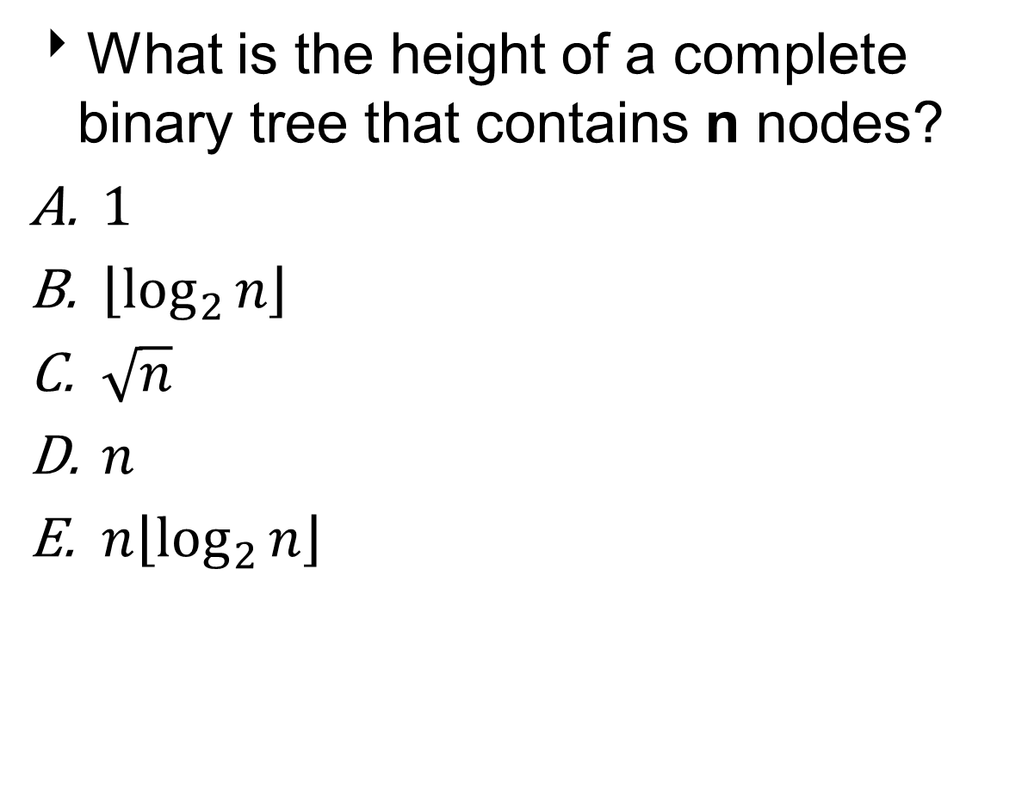
Question 2
What is the height of a complete binary tree that contains n nodes?
$1$
$\left\lfloor \log_{2}{n}\right\rfloor$
$\sqrt{n}$
$n$
$n\left\lfloor \log_{2}{n}\right\rfloor$

Slide 77
Question 2
What is the height of a complete binary tree that contains n nodes?
$1$
$\left\lfloor \log_{2}{n}\right\rfloor$
$\sqrt{n}$
$n$
$n\left\lfloor \log_{2}{n}\right\rfloor$

Slide 78
Arithmetic Expression Tree
Binary tree associated with an arithmetic expression.
internal nodes: operators
external nodes: operands
Example: Expression tree for this arithmetic expression:
(2 × (a - 1) + (3 × b))
+
×
×
2
−
3
b
a
1

Slide 79
Evaluate Arithmetic Expressions
Specialization of a post-order traversal.
Recursive method returning the value of a sub-tree.
When visiting an internal node, combine the values of the sub-trees.
Algorithm evalExpr(v)
if isExternal (v)
return v.element ()
else
x ← evalExpr(left(v))
y ← evalExpr(right(v))
◊ ← operator stored at v
return x ◊ y
+
×
×
2
−
3
2
((2 × (5 − 1)) + (3 × 2)) = 14
5
1

Slide 80
Print Arithmetic Expressions
Specialization of an in-order traversal.
Print operand or operator when visiting node.
Print “(“ before traversing left subtree.
Print “)“ after traversing right subtree.
Algorithm printExpression(v)
if left (v) ≠ null print(“(’’)
inOrder (left(v))
print(v.element ())
if right(v) ≠ null
inOrder (right(v))
print (“)’’)
+
×
×
2
−
3
b
((2 × (a − 1)) + (3 × b))
a
1

Slide 81

Decision Tree
Binary tree associated with a decision process.
internal nodes: Questions with yes/no answer.
external nodes: Decisions
Example: Whether to check email.

Slide 82
Example: Decision Tree
What is the maximum of these numbers: x₁, x₂, x₃?

Slide 83
Example: Decision Tree
What is the maximum of these numbers: x₁, x₂, x₃?
x₁ > x₂
No
Yes
x₂ > x₃
x₁ > x₃
No
Yes
No
Yes
x₃
x₂
x₃
x₁

Slide 84
Properties of Binary Trees
Notation:
n - number of nodes
e - number of external nodes (leaves)
i - number of internal nodes
h - height
Properties:
e = i + 1
n = 2e - 1
h ≤ i
h ≤ (n - 1)/2
e ≤ 2^{h}
h ≥ log₂ e
h ≥ log₂(n + 1) - 1

Slide 85
Tree Searches
Algorithms for searching tree data structures.
Breadth-First Search:
Starting at the root, explores all the nodes on a given level before exploring nodes on the next level.
A form of Level-Order Traversal.
Usually implemented with a Queue.
Depth-First Search:
Starting at the root, explores a node one level down.
Continues searching, moving down one level down, until reach a leaf.
Then backtrack to last node with a non-empty child node and repeat the search.
A form of Pre-Order Traversal.
Usually implemented with a Stack.

Slide 86
Breadth-First Search
Algorithm BFS(r) // root node of tree
Q.enqueue(r)
while(!Q.empty)
v ← Q.dequeue
mark v as visited
for all children w of v
if w is not visited
Q.enqueue(w)

Slide 87
Example: Breadth-First Search
8
3
10
1
6
14
4
7
13

Slide 88
Depth-First Search
Algorithm DFS(r) // root node of tree
S.push(r)
while(!S.empty)
v ← S.pop
mark v as visited
for all children w of v
if w is not visited
S.push(w)

Slide 89
Example: Depth-First Search
8
3
10
1
6
14
4
7
13

Slide 90
Linked Structure for Trees
A node is represented by an object storing:
Element
Parent node
Sequence of children nodes
∅
B
∅
∅
A
D
F
B
A
D
F
∅
∅
C
E
C
E

Slide 91
Linked Structure for Binary Trees
A node is represented by an object storing:
Element
Parent node
Left child node
Right child node
∅
B
∅
∅
B
A
D
A
D
∅
∅
∅
∅
C
E
C
E

Slide 92
Array-Based Representation of Binary Trees
0
A
Nodes are stored in an array A
1
2
B
D
A
B
D
…
G
H
…
0
1
2
9
10
3
4
5
6
E
F
C
J
Node v is stored at A[rank(v)]
rank(root) = 0
If node is the left child of parent(node), rank(node) = 2*rank(parent(node)) + 1
If node is the right child of parent(node), rank(node) = 2*rank(parent(node)) + 2
9
10
G
H

Slide 94
Tree ADT
We use positions to abstract nodes
Generic methods:
integer size()
boolean isEmpty()
Iterator iterator()
Iterable positions()
Accessor methods:
position root()
position parent(p)
Iterable children(p)
Integer numChildren(p)
Query methods:
boolean isInternal(p)
boolean isExternal(p)
boolean isRoot(p)
Additional update methods may be defined by data structures implementing the Tree ADT

Slide 95
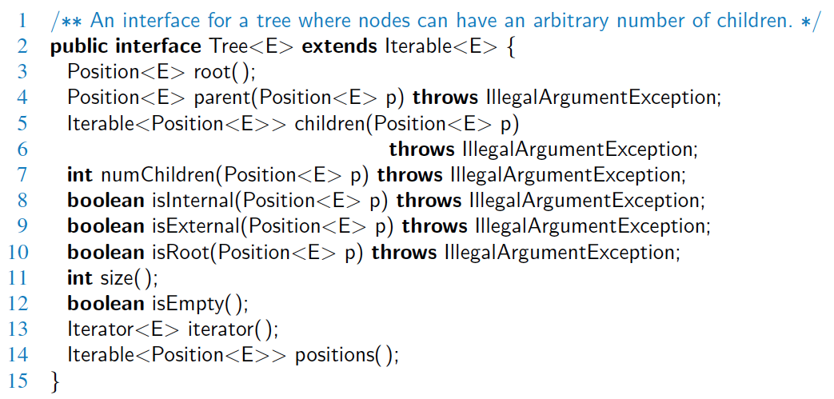
Java Interface
Methods for a Tree interface:

Slide 96
BinaryTree ADT
The BinaryTree ADT extends the Tree ADT, i.e., it inherits all the methods of the Tree ADT
Additional methods:
position left(p)
position right(p)
position sibling(p)
The above methods return null when there is no left, right, or sibling of p, respectively
Update methods may be defined by data structures implementing the BinaryTree ADT

Slide 97
Euler Tour Traversal
Generic traversal of a binary tree
Includes a special cases the preorder, postorder and inorder traversals
Walk around the tree and visit each node three times:
on the left (preorder)
from below (inorder)
on the right (postorder)
+
L
×
R
×
B
2
−
3
2
5
1

